Slide 1
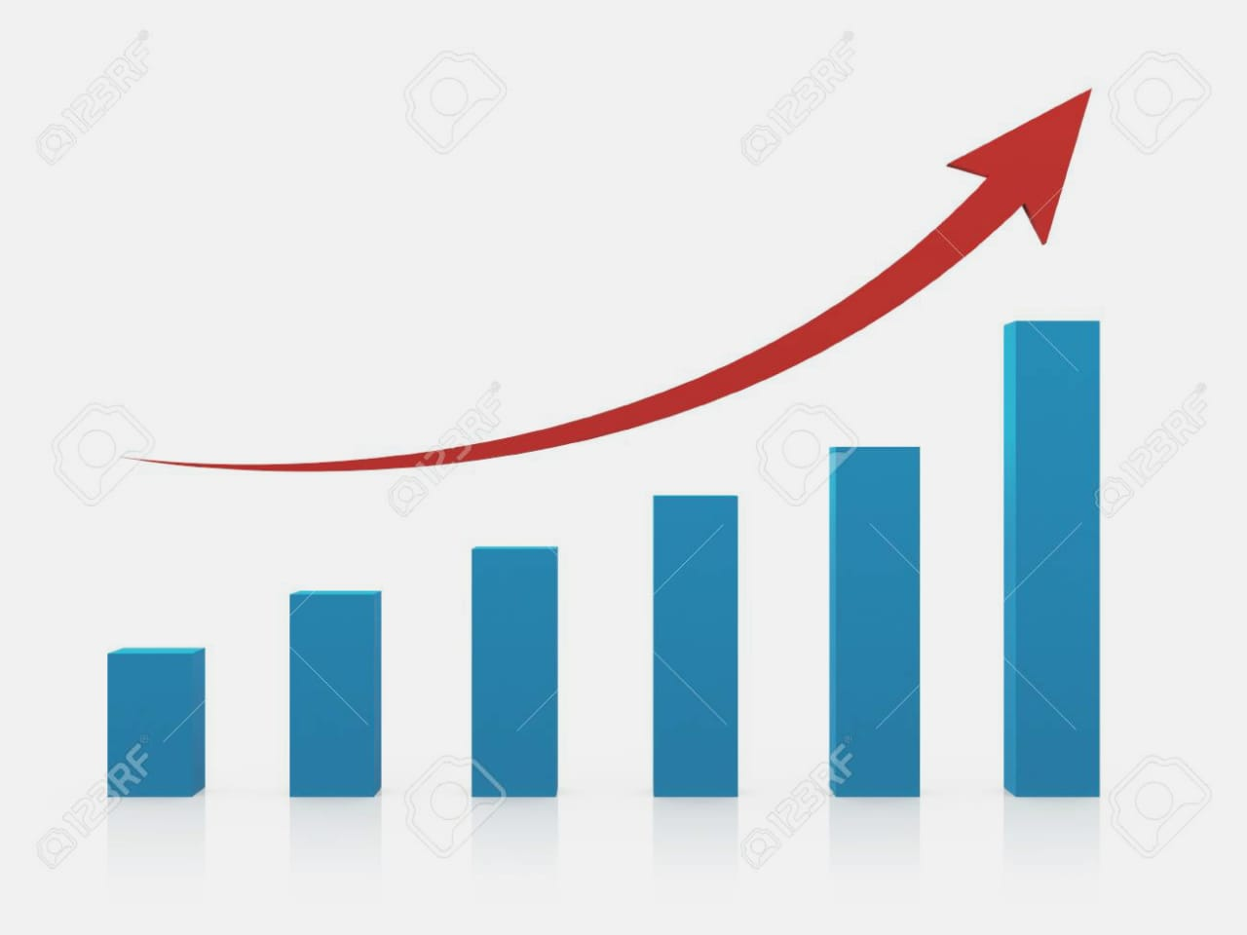
PROJECT TITLE
ESTIMATION OF BUSINESS EXPENSES
TEAM ID: NM2023TMID08155 TEAM LEADER: ADHISTA.J TEAM MEMBERS: ADLIN BERLISHA.J ANCY.A ANISHA.R

Slide 2
PROJECT REPORT
INTRODUCTION
OVERVIEW
PURPOSE
PROBLEM DEFINITION & DESIGN THINKING
EMPATHY MAP
IDEATION & BRAIN STROMING MAP
RESULT
ADVANTAGES & DISADVANTAGES
APPLICATION
CONCLUSION
FUTURE SCOPE
APPENDIX

Slide 3
ESTIMATION OF BUSINESS EXPENSES
INTRODUCTION
PROJECT DESCRIPTION
The “ESTIMATION OF BUSINESS EXPENSES” project aims to create a comprehensive system for accurately forecasting and managing the expenses of a business. Managing expenses is crucial for the financial health and sustainability of any organization, and this project seeks to provide an efficient and data-driven solution for this purpose.
By estimation of business expenses the profit increases and there will not be any confusions in the business. The business gets improved and the system helps in identifying cost-saving opportunities and controlling unnecessary spending. Accurate expenses data and insights empower management to make informed decisions regarding resources allocation and strategy.

Slide 4
PURPOSE
The purpose of estimating business expenses is multifaceted and serves several critical functions within an organisation. Expense estimation enables businesses to forecast and plan their finances effectively. It is crucial for creating and maintaining budgets.
Accurate expenses estimates assist in allocating resources, such as funds, personnel, and material, to different areas of the business based on anticipated needs. Expenses estimation allows companies to identify areas where they can control costs and reduce unnecessary expenditure.
Accurate expense estimation provides valuable insights for strategic decision-making. It helps executive and management prioritize initiatives, investments, and cost-cutting strategies bases on financial projections.

Slide 5
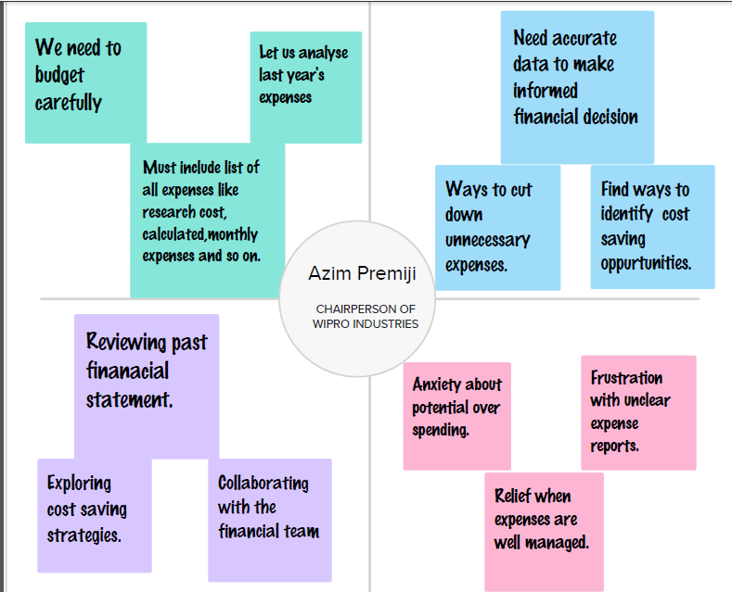
PROBLEM DEFINITION & DESIGN THINKING
The objective of the problem definition in estimation of business expenses is to develop
a systematic and accurate method for estimating and managing business expenses within an organisation. Accurate expense estimating is crucial for financial planning, budgeting, and overall business sustainability.
EMPATHY MAP

Slide 6
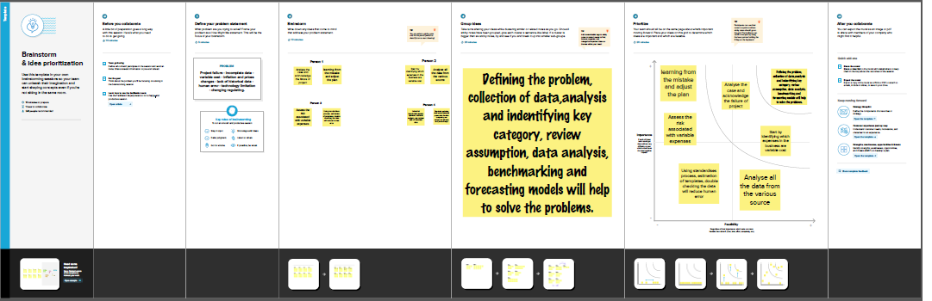
IDEATION & BRAINSTORMING MAP

Slide 7
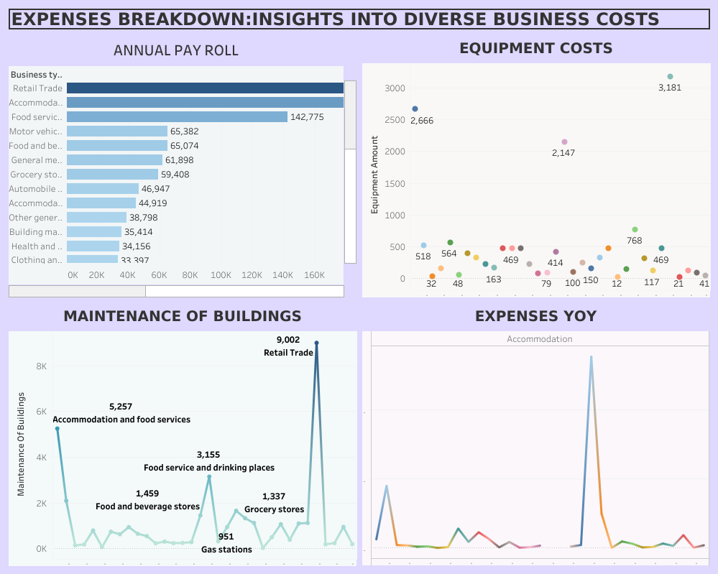
RESULT
DASHBOARD 1

Slide 8
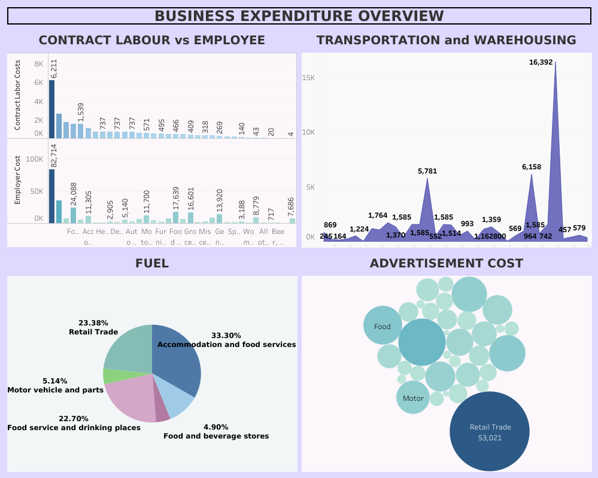
DASHBOARD 2

Slide 9
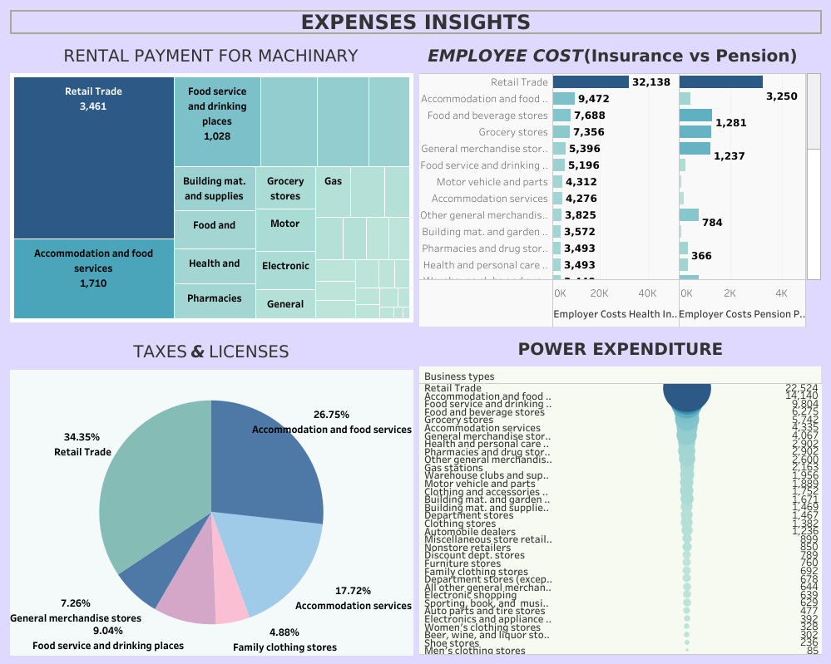
DASHBOARD 3

Slide 10
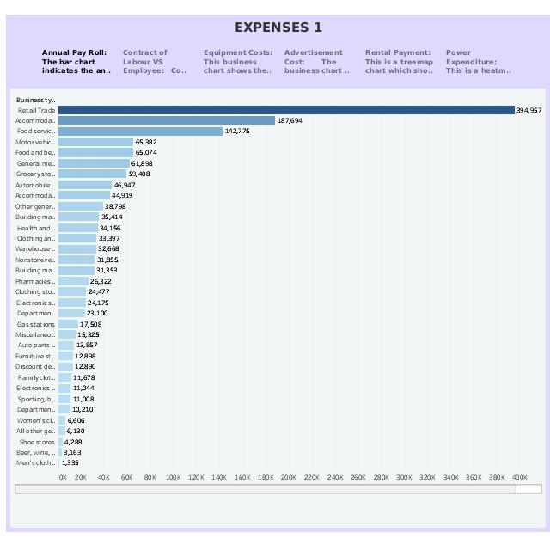
STORY

Slide 11
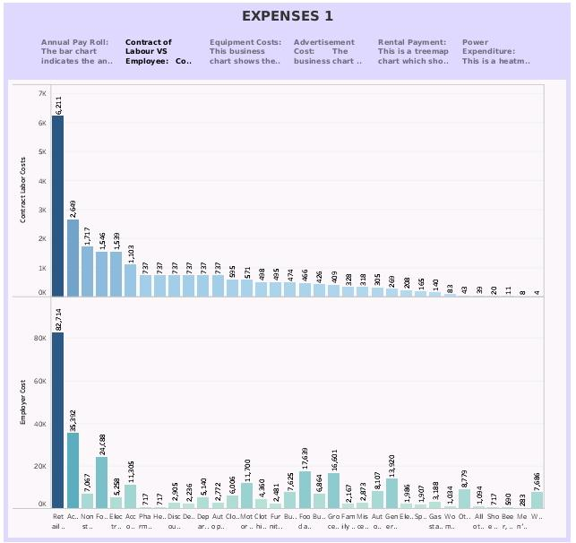

Slide 12
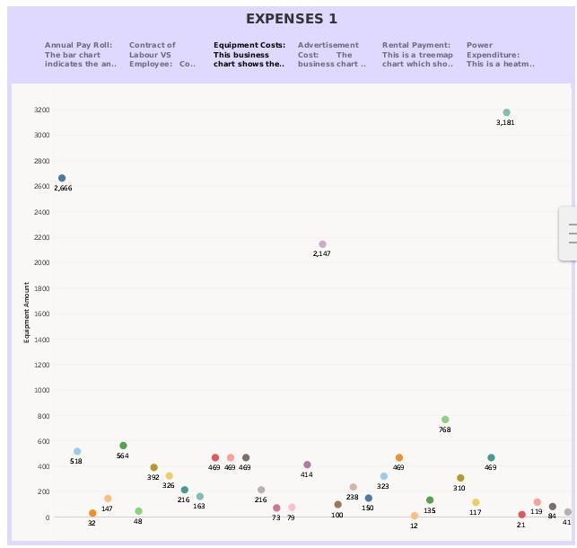

Slide 13
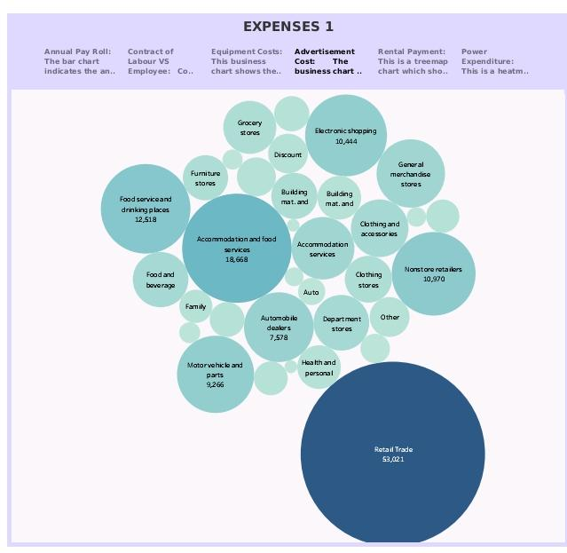

Slide 14
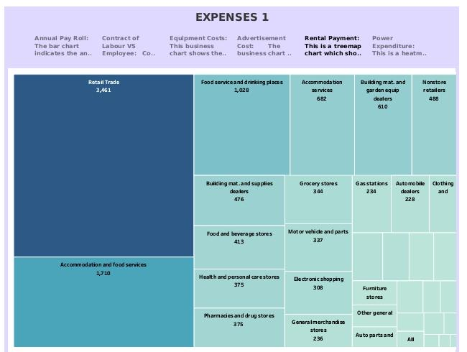

Slide 15
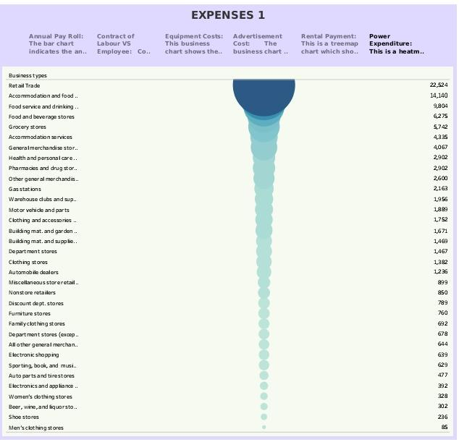

Slide 16
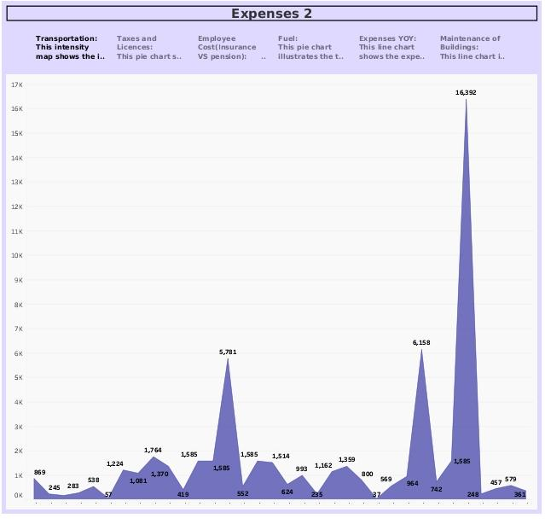

Slide 17
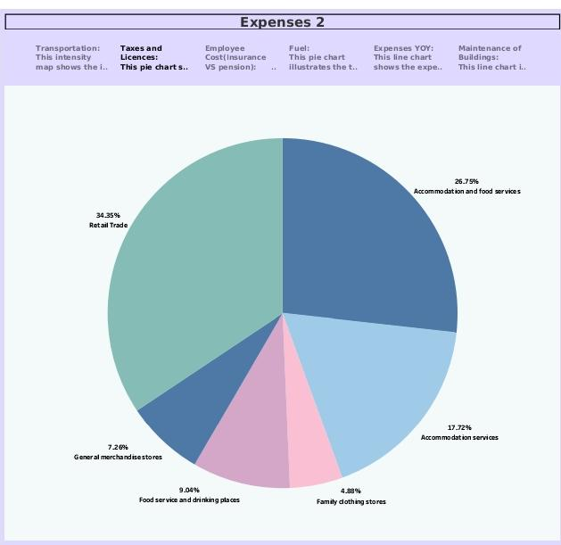

Slide 18
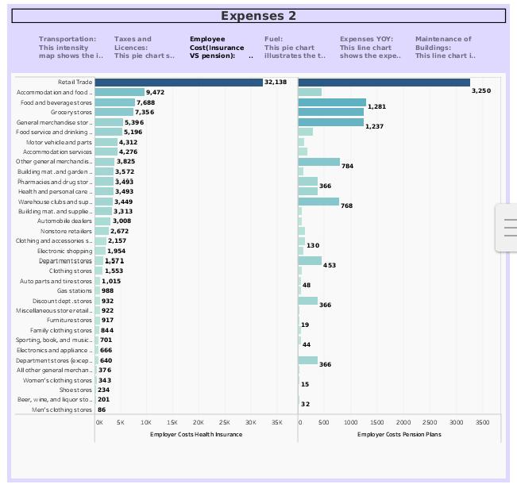

Slide 19
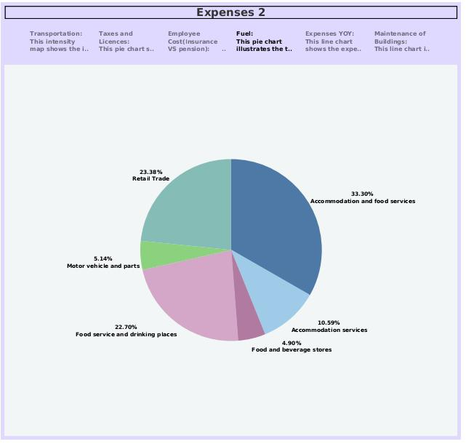

Slide 20
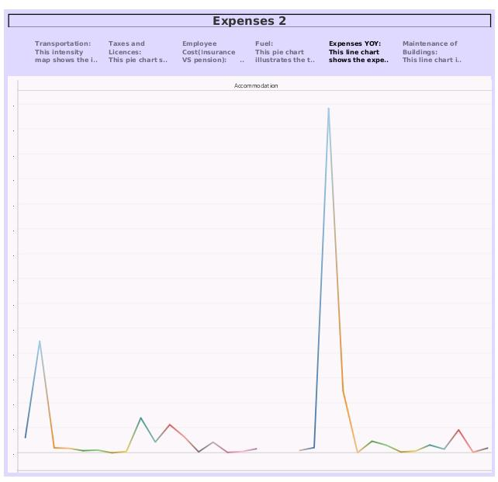

Slide 21
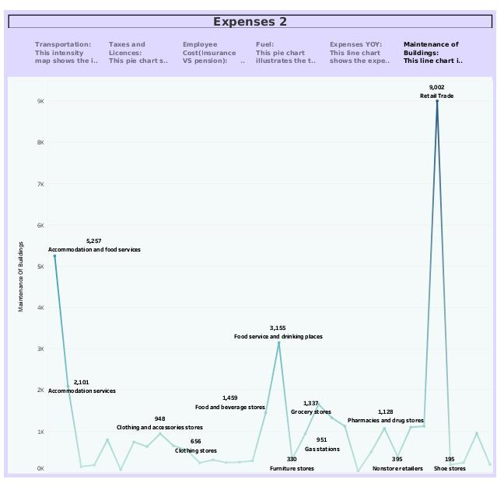

Slide 22
ADVANTAGES & DISADVANTAGES
ADVANTAGES
Estimation of business expenses helps in creating a budget and setting financial goals for the business. It allows for monitoring and controlling expenses to prevent overspending. This estimation informs strategic decisions by identifying areas where cost-saving measures can be implemented.
This helps to maintain a healthy cash flow by predicting when and how much money is needed. Accurate expense estimates aid in tax planning and reduce the risk of overpaying taxes.
It allows for benchmarking against industry standards and competitors to stay competitive. Estimation of business expenses is crucial for financial stability, growth, and informed decision-making.

Slide 23
DISADVANTAGES
There is not many disadvantage in ESTIMATION OF BUSINESS EXPENSES. One of the
disadvantage in the estimation of business expenses is the potential for inaccuracies.
Estimations are inherently uncertain and may not always reflect the actual costs
accurately, leading to budgeting issues and financial support.
APPLICATION
The estimation of business expenses is crucial for various applications, including:
BUDGETING: Estimating expenses helps businesses create budgets for various timeframes, enabling then to allocate resources efficiently and plan for future financial needs.
PRICING: Estimations help determine the pricing of products or services, ensuring that costs are covered and profit margins are maintained.

Slide 24
3. FINANCIAL PLANNING: It supports financial planning and forecasting, allowing businesses to set realistic financial goals and make informed decisions regarding investments, loans and growth strategies.
4. TAX PLANNING: Estimating expenses accurately is essential for tax planning, as it affects the calculation of taxable income and tax liability.
5.INVESTOR RELATIONS: Investors and stakeholders often rely on expenses estimations to assess a company’s financial health and stability.
CONCLUSIONS
Estimation of business expenses is a critical financial practice with numerous implications for budgeting, financing planning, cost control, pricing, and decision making.
Accurate expense estimations are essential for the overall financial health and success of a business.

Slide 25
FUTURE SCOPE
The future scope of estimation of business expenses is likely to see several developments and trends in various fields. Advanced Technology like automation, artificial intelligence, and machine language will play a significant role in expense estimation. It also plays an important role in data integration, predictive analytics, real time tracking, regulatory changes, cyber security and so on.

